Slide 1
Song Recommendation System
Team 8
Name ID
Raghu Varan Sharma Bhagavatham 11543836
Ainavolu Venkata Anoop Ra 11518650
Vamsi Krishna Kunta 11525411
Revathi Mudduluru 11545180
Kaushic kolla 11520251

Slide 2
Introduction
With the rise of digital content distribution, we have access to a huge music collection. With millions of songs to choose from, we sometimes feel overwhelmed. Thus, an efficient music recommender system is necessary in the interest of both music service providers and customers Our music recommender system is large-scale and personalized. We learn from users’ listening history and features of songs and predict songs that a user would like to listen to.

Slide 3
WHY A RECOMMENDER SYSTEM?
Music dataset is too big while life is short!!!! You need someone to teach you how to manage and give you wisesuggestions according to your taste! Music service providers need a more efficient system to attraction their clients

Slide 4
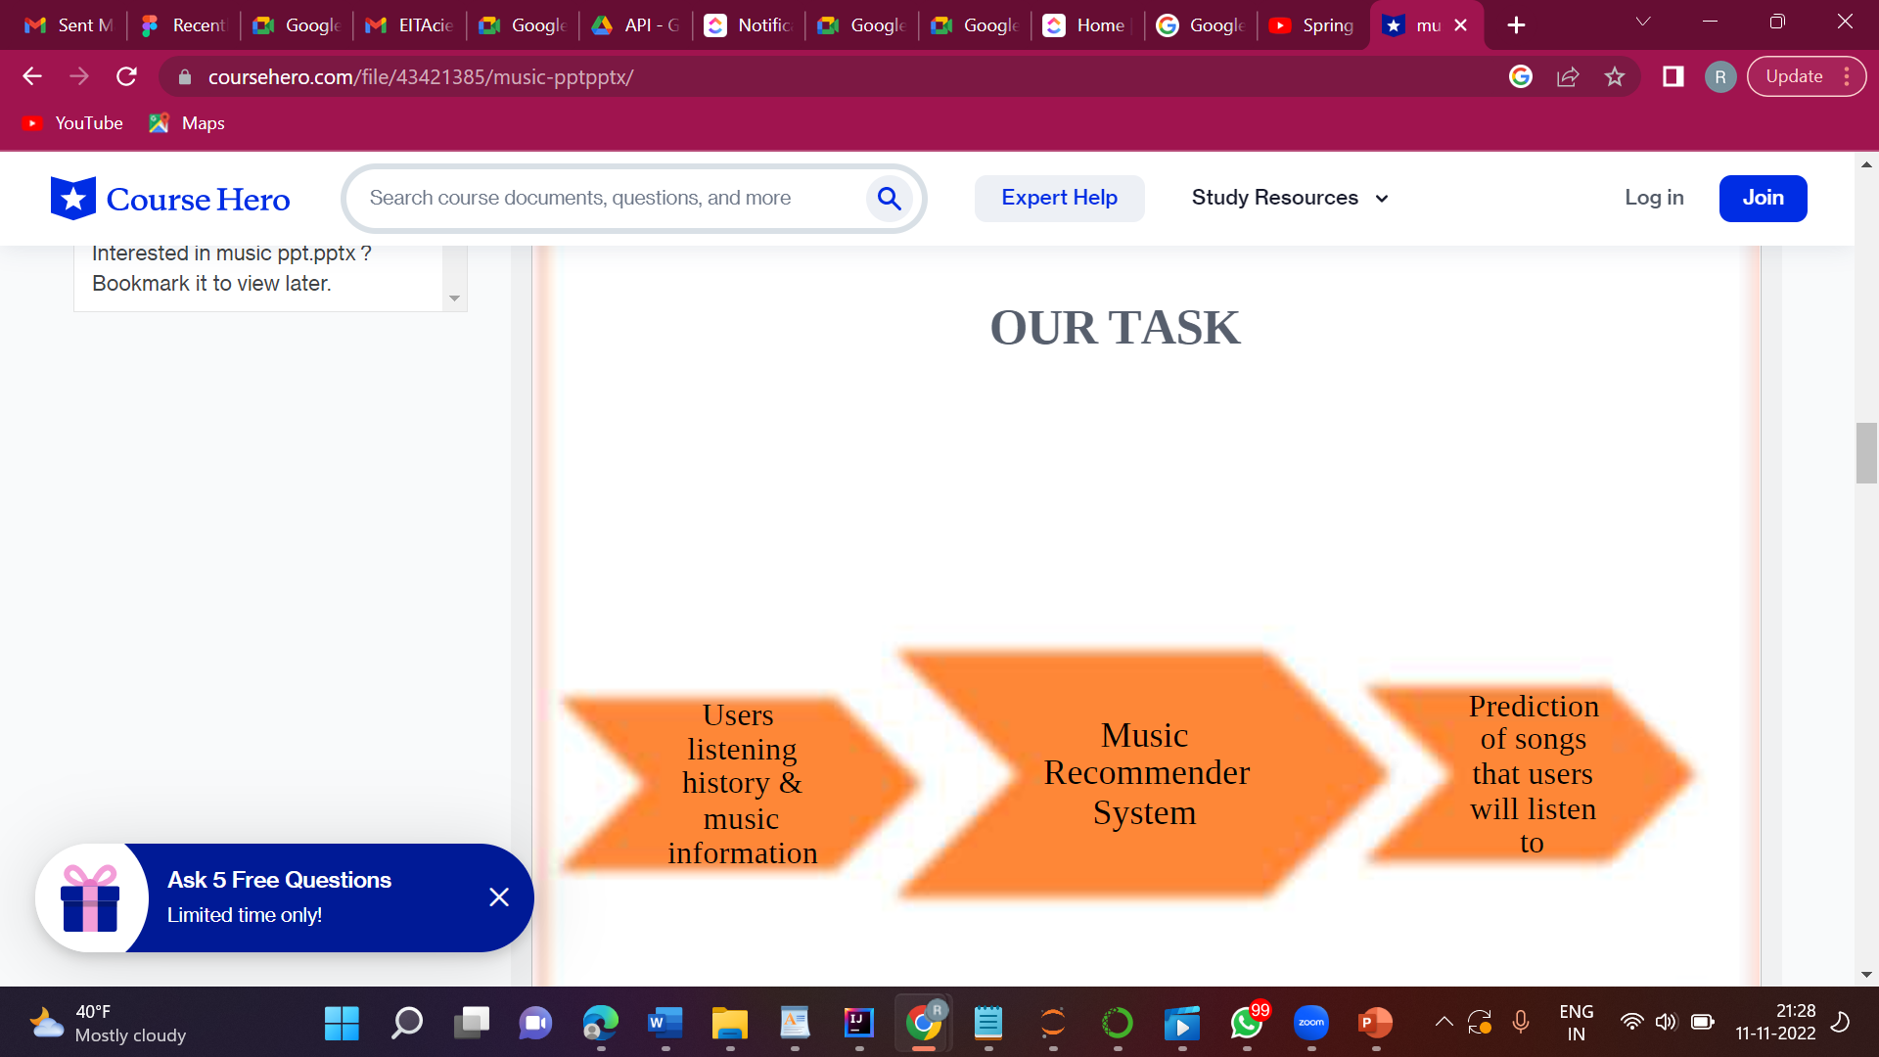

Slide 5
Tools To be used

Slide 6
pandas
Pandas is an open-source Python package that is most widely used for data science/data analysis and machine learning tasks. It is built on top of another package named Numpy, which provides support for multi-dimensional arrays. As one of the most popular data-wrangling packages, Pandas works well with many other data science modules inside the Python ecosystem and is typically included in every Python distribution, from those that come with your operating system to commercial vendor distributions like ActiveState’s ActivePython.

Slide 7
Numpy
In Python we have lists that serve the purpose of arrays, but they are slow to process.
NumPy aims to provide an array object that is up to 50x faster than traditional Python lists.
The array object in NumPy is called ndarray, it provides a lot of supporting functions that make working with ndarray very easy.
Arrays are very frequently used in data science, where speed and resources are very important.

Slide 8
Matplotlib
Matplotlib is a cross-platform, data visualization, and graphical plotting library for Python and its numerical extension NumPy. As such, it offers a viable open-source alternative to MATLAB. We can also use matplotlib’s APIs (Application Programming Interfaces) to embed plots in GUI applications.

Slide 9
Tensorflow
TensorFlow is a Python library for fast numerical computing created and released by Google.
It is a foundation library that can be used to create Deep Learning models directly or by using wrapper libraries that simplify the process built on top of TensorFlow.

Slide 10
scipy
SciPy is a scientific computation library that uses NumPy underneath.
SciPy stands for Scientific Python.
It provides more utility functions for optimization, stats and signal processing.
Like NumPy, SciPy is open source so we can use it freely.

Slide 11
sklearn
Scikit-learn is a key library for the Python programming language that is typically used in machine learning projects. Scikit-learn is focused on machine learning tools including mathematical, statistical, and general-purpose algorithms that form the basis for many machine learning technologies.

Slide 12
React js
The React.js framework is an open-source JavaScript framework and library developed by Facebook. It’s used for building interactive user interfaces and web applications quickly and efficiently with significantly less code than you would with vanilla JavaScript. We will use React JS to build our front end.

Slide 13
THANK YOU

